Slide 1

Capstone Project: NLP Sentiment Analysis on Rotten Tomatoes Comments
Kelvin Lim (DSI 10)

Slide 2
Table of Contents
Problem Statement
Data Set
Data Cleaning/Preparation
Machine Learning Modelling
Deep Learning Data Preparation
Deep Learning Modelling
Conclusion

Slide 3
1. Problem Statement
Predict whether a certain comment made on Rotten Tomatoes is Fresh (Positive) or Not Fresh (Negative)
Techniques used:
Machine Learning
Deep Learning

Slide 4

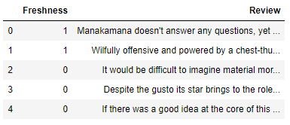
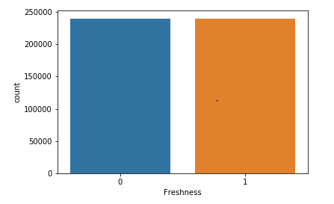
2. Data Set
480,000 rows of comments scraped from Rotten Tomatoes Website.
240,000 Fresh
240,000 Not Fresh
Randomly shuffled all rows in Excel.

Slide 5
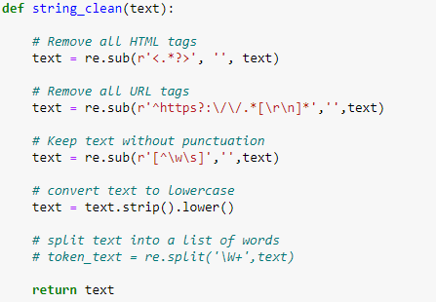
3. Data Cleaning/Preparation
Using Regex function to remove all irrelevant items from comments

Slide 6
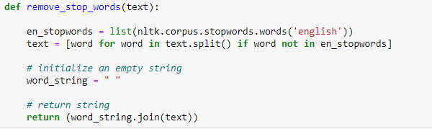
3. Data Cleaning/Preparation
Using NLTK stopwords to remove stop words from comments

Slide 7
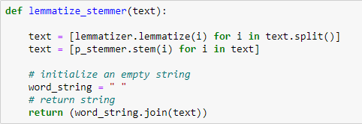
3. Data Cleaning/Preparation
Using NLTK Lemmatizer and Stemmer on comments

Slide 8
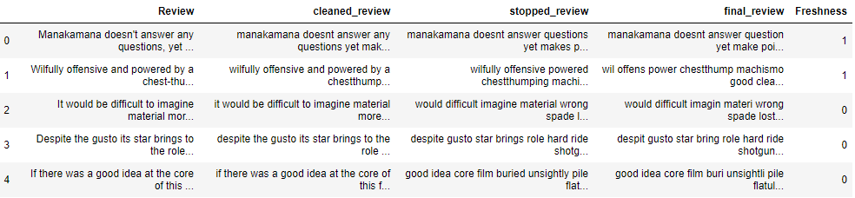
3. Data Cleaning/Preparation
Cleaned_review = Regex used
Stopped_review = NLTK stopwords function used
Final_review = Lemmatized and Stemmed

Slide 9
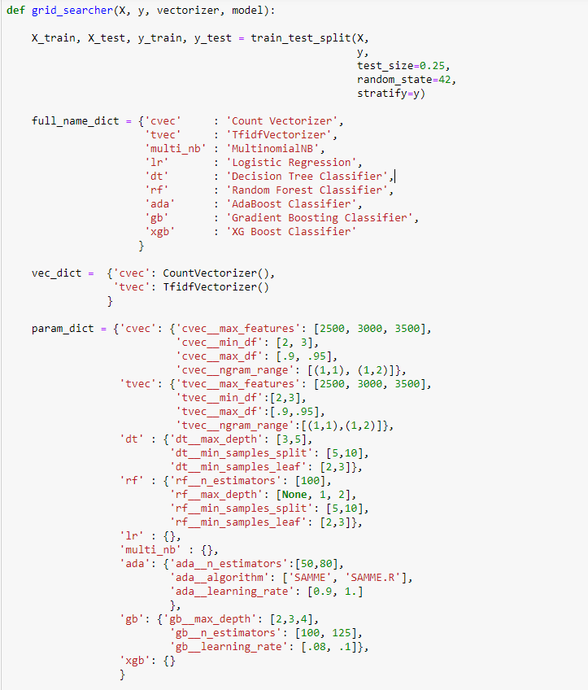
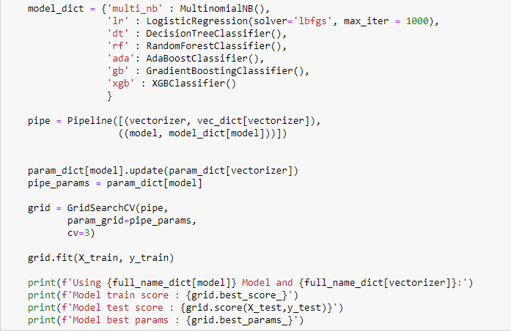
4. Machine Learning Modelling
Written function to run GridSearch on various Machine Learning Models.

Slide 10

4. Machine Learning Modelling
Models ran (both with and without Lemmatizing/Stemming):
Logistic Regression with Count Vectorizer
Logistic Regression with Tfidf Vectorizer
Multinomial NB with Count Vectorizer
Multinomial NB with Tfidf Vectorizer
Random Forest Classifier with Count Vectorizer
Random Forest Classifier with Tfidf Vectorizer
XGBoost with Count Vectorizer
XGBoost with Tfidf Vectorizer

Slide 11
4. Machine Learning Modelling
Without Lemmatization/Stemming | Training | Validation
Logistic Regression with Count Vectorizer | 0.76445 | 0.76668
Logistic Regression with Tfidf Vectorizer | 0.76470 | 0.76708
Multinomial NB with Count Vectorizer | 0.75575 | 0.75650
Multinomial NB with Tfidf Vectorizer | 0.75568 | 0.75604
Random Forest Classifier with Count Vectorizer | 0.52131 | 0.51882
Random Forest Classifier with Tfidf Vectorizer | 0.52142 | 0.51880
XGBoost with Count Vectorizer | 0.64125 | 0.64263
XGBoost with Tfidf Vectorizer | 0.64382 | 0.64423

Slide 12
4. Machine Learning Modelling
With Lemmatization/Stemming | Training | Validation
Logistic Regression with Count Vectorizer | 0.76822 | 0.76828
Logistic Regression with Tfidf Vectorizer | 0.76836 | 0.76830
Multinomial NB with Count Vectorizer | 0.75916 | 0.75953
Multinomial NB with Tfidf Vectorizer | 0.75869 | 0.75868
Random Forest Classifier with Count Vectorizer | 0.52926 | 0.52312
Random Forest Classifier with Tfidf Vectorizer | 0.53021 | 0.52313
XGBoost with Count Vectorizer | 0.65086 | 0.65277
XGBoost with Tfidf Vectorizer | 0.65193 | 0.65310

Slide 13
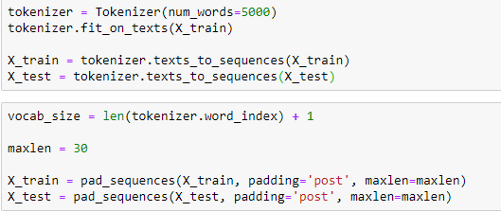
5. Deep Learning Data Preparation
Create a word-to-index dictionary
Padding so that lists with size greater than 30 will be truncated to 30 and lists with lesser than 30, zeros are added to the list until it reaches the max length.

Slide 14
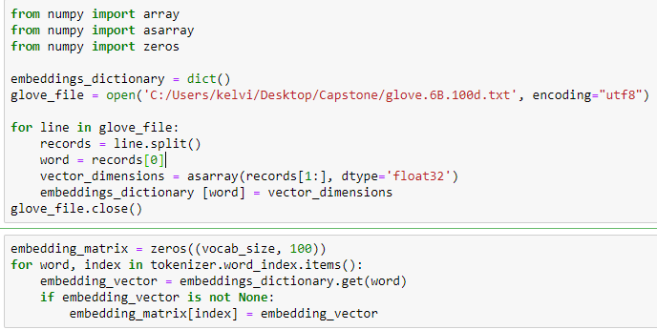
5. Deep Learning Data Preparation
Creating embedding matrix using GloVe Embeddings
Creates a dictionary that will contain words as keys and their corresponding embedding list as values.

Slide 15
6. Deep Learning Modelling
Models ran:
Simple Neural Network
Training on single Embedding layer
Convolutional Neural Network (CNN)
Training on single CONV1D layer
Recurrent Neural Network (RNN)
Training on single LSTM layer

Slide 16
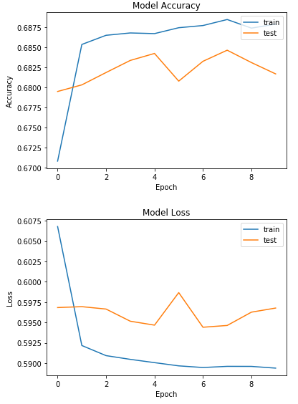
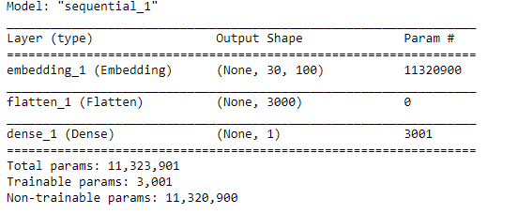
6. Deep Learning Modelling
Simple Neural Network
Test Score: 0.59324
Training Score: 0.68534

Slide 17
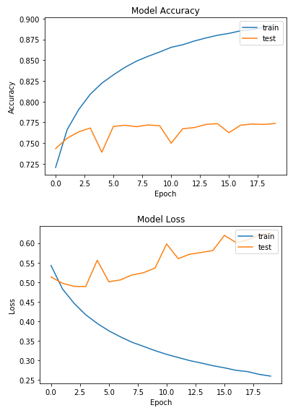
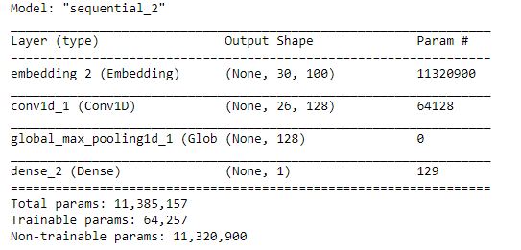
6. Deep Learning Modelling
Convolutional Neural Network
Test Score: 0.61662
Training Score: 0.77802

Slide 18
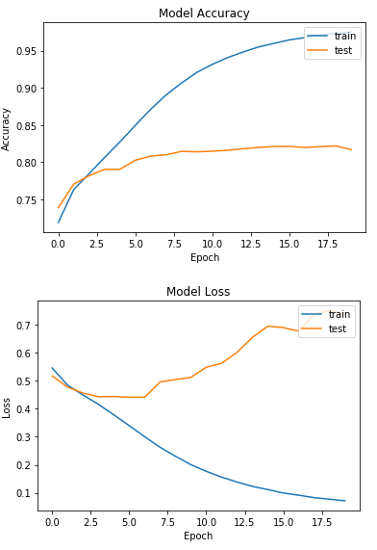
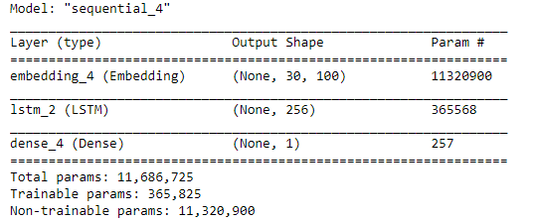
6. Deep Learning Modelling
Recurrent Neural Network
Test Score: 0.7506
Training Score: 0.81745

Slide 19
6. Deep Learning Modelling (Observations)
Unrepresentative train dataset (RNN)
Training Dataset has too few examples as compared to the validation data set.
Unrepresentative test dataset (Simple NN and CNN)
Validation dataset does not provide sufficient information to evaluate the ability of the model to generalize. (Shown by noisy movements around training loss.)
How to rectify: More data could be scraped and training/testing sizes can be tweaked accordingly to achieve better results.

Slide 20
7. Conclusion
Will rather default to Machine Learning for deployment in real life scenario for such problems.
Neural Networks require much more understanding compared to Machine Learning.
Hard to interpret Neural Networks, even though RNN (with just 1 LSTM layer) seems to give the best results.

Slide 21
The End
No model is too simple to utilize
Data Science does not need to be as complex as people say.
Sometimes, a simple approach and good intuition is all we need.

